Slide 1
Job Analysis Project
ZAID AHAMED

Slide 2
Objective
The main goal of this project is to analyze job postings to identify trends and insights in job requirements, such as in-demand skills, education levels, and experience.
This analysis will help job seekers and recruiters understand the current job market.

Slide 3
Scope
Data Source: Job postings were collected from (http://www.topjobs.lk) using a Python web scraping script (Beautiful Soup). This analysis include data from June to September 2024.
Key Data Fields: Job Title, Company, Skills, Education, Experience, and Job Links.
Time Frame: The data was scraped weekly to capture recent trends.
Tools Used: Python (scraping and cleaning), Excel (data storing and organization), PowerBI (dashboarding).

Slide 4
Approach
Data Collection
- Scraped job postings weekly.
- Extracted key fields: Job Title, Company, Job Link.
Data Cleaning and Transformation
Filtered only relevant job postings using Python (data analyst, data engineer, data scientist, python, cloud, cyber security).
Manually inserted and populated additional columns such as Skills, Education, Experience using data from job-specific links.
Dashboard Creation
Built an interactive dashboard in PowerBI to visualize key metrics such as in-demand skills, required experience, and education levels.

Slide 5
Current Status
Data Collection: Job data is successfully being collected and added weekly.
Data Cleaning: Completed after every data collection, ensuring only relevant data is used.
Dashboard: An operational PowerBI dashboard visualizes trends and insights.

Slide 6
Future Expansion
1. Automating the Process:
Fully automate data scraping, cleaning, and transformation tasks to reduce manual input.
2. Prediction Model:
Build a predictive model to forecast future job trends and in-demand skills based on the current data.
3. System Deployment:
- Deploy this job analysis system on a website.
Integrate GenAI (LLM) to provide job seekers with personalized job recommendations and insights.

Slide 7
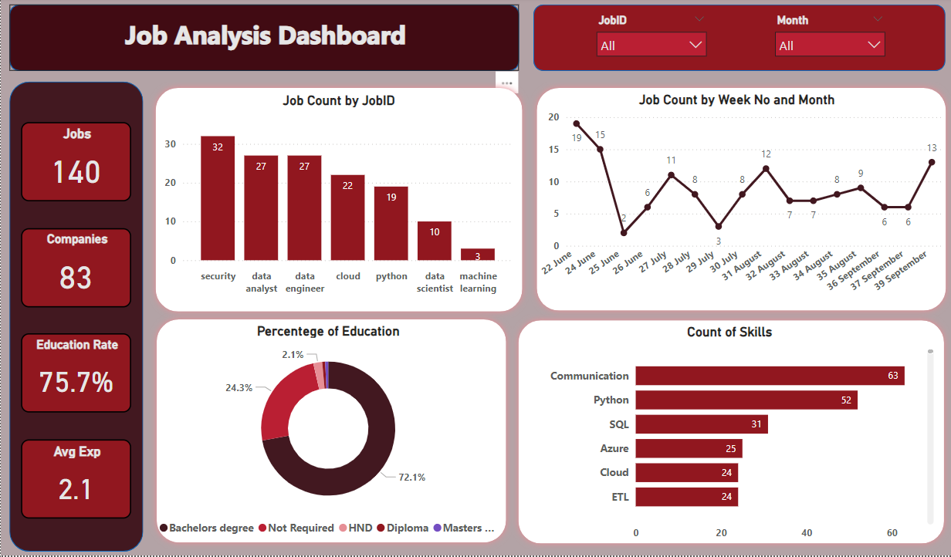
Dashboard

Slide 8
Data Insights (from June to September 2024)
Job Titles
- There are 140 jobs in the dataset.
The most jobs are related to Information Security.
Trend of job counts are fluctuating.
Companies
A total of 86 unique companies are represented in the job postings.
The most companies are hiring jobs related to Data Analyst.

Slide 9
Data Insights (from June to September 2024)
Education Levels:
The majority of job postings require a Bachelor’s degree.
Most of the entry level jobs are not required a higher education levels and some of them are required Diploma or HND (Higher National Diploma).
Some senior level job positions are required to have Master’s degree.
Data Engineering jobs required least percentage of education (63%).

Slide 10
Data Insights
Experience:
Most of the entry-level jobs require no experience.
Least average experience require for Data Analyst (1.3 years) and Data Scientist (1.2 years) while Most Average experience require for Machine Learning Engineer Position (4.3 years).
The lead and senior level job positions are required highest experience like 5 to 9 years.

Slide 11
Data Insights
Skills
Communication is most relevant skill for every job.
Most demanded skills are:
Python
Expertise in Python language
Working with APIs
Flask and Django
Cloud Technologies

Slide 12
Data Insights
Skills
Data Analyst
Python, SQL, Excel, PowerBI
Data Scientist
Python, SQL, Statistics
Data Analysis, Machine Learning

Slide 13
Data Insights
Skills
Data Engineer
Python, SQL
ETL / ELT , Pipeline Building
Database, Cloud Technologies, Data Warehouse
Machine Learning Engineer
Python, APIs
Cloud Technologies

Slide 14
Data Insights
Skills
Cloud Engineer
Cloud Technologies (Azure, AWS)
DevOps, Containers, CI/CD
Databases, Linux
Information Security / Cyber Security
Certifications (CISSP, CEH)
Networking, Cloud Technologies, VAPTs, Operating Systems

Slide 15
Recommendations
For Job Seekers
For Companies
Focus on Communication as it is the most sought-after skill.
If you're entering the Data field, proficiency in Python, SQL and ETL will make you more competitive.
Most job postings prefer candidates with a Bachelor's degree, so it's worth completing this level of education if possible.
Companies should consider offering training in top-demand skills like Communication, Python, and SQL to bridge any skill gaps in their current workforce.
Since many jobs are open to entry-level candidates (0-2 years of experience), companies might benefit from providing internships and training programs to attract fresh talent.

Slide 16
Conclusion
The project has successfully collected, cleaned, and analyzed job posting data to provide insights into the job market.
Future improvements will focus on automating data collection, building predictive capabilities, and enhancing accessibility via a web interface with AI integration.

Slide 17
Thank You

